Slide 1
A Guide to SQL, Ninth Edition
Chapter Eight
SQL Functions and Procedures

Slide 2
Objectives
Understand how to use functions in queries
Use the UPPER and LOWER functions with character data
Use the ROUND and FLOOR functions with numeric data
Add a specific number of months or days to a date
©2016 Cengage Learning. All Rights Reserved. May not be copied, scanned, or duplicated, in whole or in part, except for use as permitted in a license distributed with a certain product or service or otherwise on a password-protected website for classroom use.

Slide 3
Objectives (continued)
Calculate the number of days between two dates
Use concatenation in a query
Embed SQL commands in PL/SQL and
T-SQL procedures
Retrieve single rows using embedded SQL
Update a table using embedded INSERT, UPDATE, and DELETE commands
©2016 Cengage Learning. All Rights Reserved. May not be copied, scanned, or duplicated, in whole or in part, except for use as permitted in a license distributed with a certain product or service or otherwise on a password-protected website for classroom use.

Slide 4
Objectives (continued)
Use cursors to retrieve multiple rows in embedded SQL
Manage errors in procedures containing embedded SQL commands
Use SQL in a language that does not support embedded SQL commands
Use triggers
©2016 Cengage Learning. All Rights Reserved. May not be copied, scanned, or duplicated, in whole or in part, except for use as permitted in a license distributed with a certain product or service or otherwise on a password-protected website for classroom use.

Slide 5
Using SQL in a Programming Environment
SQL is a nonprocedural language
  Use simple commands to communicate tasks to computer
PL/SQL is a procedural language
  Must provide step-by-step process for accomplishing tasks
Can embed SQL in another language, such as PL/SQL or T-SQL (SQL Server)
©2016 Cengage Learning. All Rights Reserved. May not be copied, scanned, or duplicated, in whole or in part, except for use as permitted in a license distributed with a certain product or service or otherwise on a password-protected website for classroom use.

Slide 6
Using SQL in a Programming Environment (continued)
Useful when needed tasks are beyond the capabilities of SQL
Cannot embed SQL commands in Access programs
©2016 Cengage Learning. All Rights Reserved. May not be copied, scanned, or duplicated, in whole or in part, except for use as permitted in a license distributed with a certain product or service or otherwise on a password-protected website for classroom use.

Slide 7
Using Functions
Aggregate functions
  Perform calculations based on groups of records
  SUM is an example
Other SQL functions
  Affect single records
  Vary from one SQL implementation to another
©2016 Cengage Learning. All Rights Reserved. May not be copied, scanned, or duplicated, in whole or in part, except for use as permitted in a license distributed with a certain product or service or otherwise on a password-protected website for classroom use.

Slide 8
Character Functions
UPPER function
  Displays a value in uppercase letters
  Function operates on an argument
LOWER function
  Displays a value in lowercase letters
Can use functions in WHERE clauses
Access uses UCASE and LCASE
©2016 Cengage Learning. All Rights Reserved. May not be copied, scanned, or duplicated, in whole or in part, except for use as permitted in a license distributed with a certain product or service or otherwise on a password-protected website for classroom use.

Slide 9
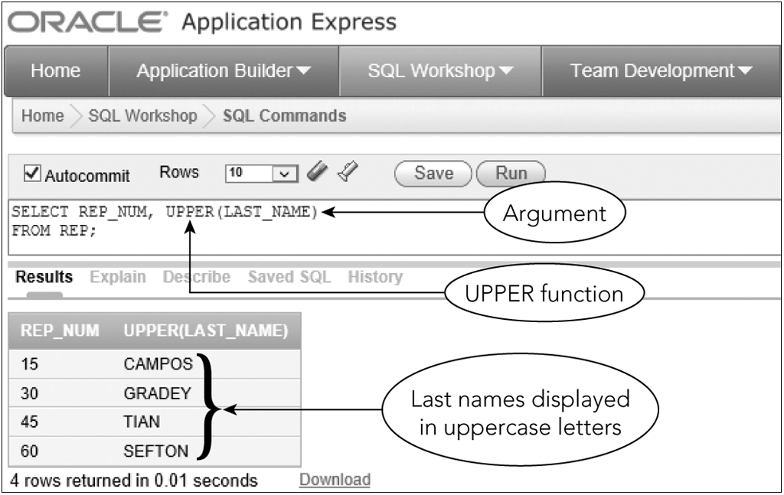
Character Functions (continued)
Figure 8-1: Using the UPPER function to display character data in uppercase letters
©2016 Cengage Learning. All Rights Reserved. May not be copied, scanned, or duplicated, in whole or in part, except for use as permitted in a license distributed with a certain product or service or otherwise on a password-protected website for classroom use.

Slide 10
Number Functions
ROUND
  Rounds values to a specified number of decimal places
  Requires two arguments
FLOOR
  Truncates everything to the right of the decimal place
  Not supported by Access
©2016 Cengage Learning. All Rights Reserved. May not be copied, scanned, or duplicated, in whole or in part, except for use as permitted in a license distributed with a certain product or service or otherwise on a password-protected website for classroom use.

Slide 11
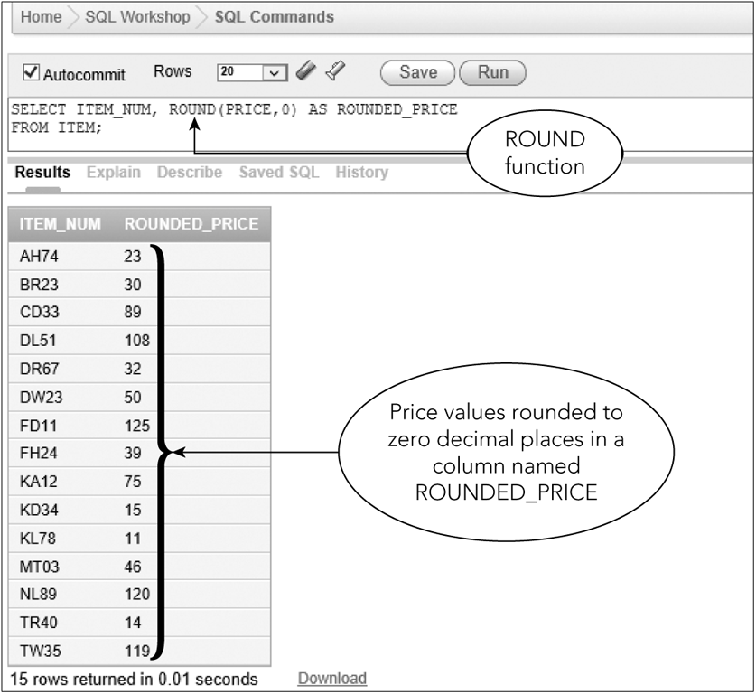
Number Functions (continued)
Figure 8-2: Using the ROUND function to round numeric values
©2016 Cengage Learning. All Rights Reserved. May not be copied, scanned, or duplicated, in whole or in part, except for use as permitted in a license distributed with a certain product or service or otherwise on a password-protected website for classroom use.

Slide 12
Working with Dates
ADD_MONTHS
  Adds a specific number of months to a date
  Has two arguments
  Access and SQL Server use DATEADD function to add months
Add a specific number of days
  Use a simple calculation
  Can also subtract
©2016 Cengage Learning. All Rights Reserved. May not be copied, scanned, or duplicated, in whole or in part, except for use as permitted in a license distributed with a certain product or service or otherwise on a password-protected website for classroom use.

Slide 13
Working with Dates (continued)
SYSDATE
  Obtains today’s date (Oracle)
DATE()
  Obtains today’s date (Access)
GETDATE()
  Obtains today’s date (SQL Server)
©2016 Cengage Learning. All Rights Reserved. May not be copied, scanned, or duplicated, in whole or in part, except for use as permitted in a license distributed with a certain product or service or otherwise on a password-protected website for classroom use.

Slide 14
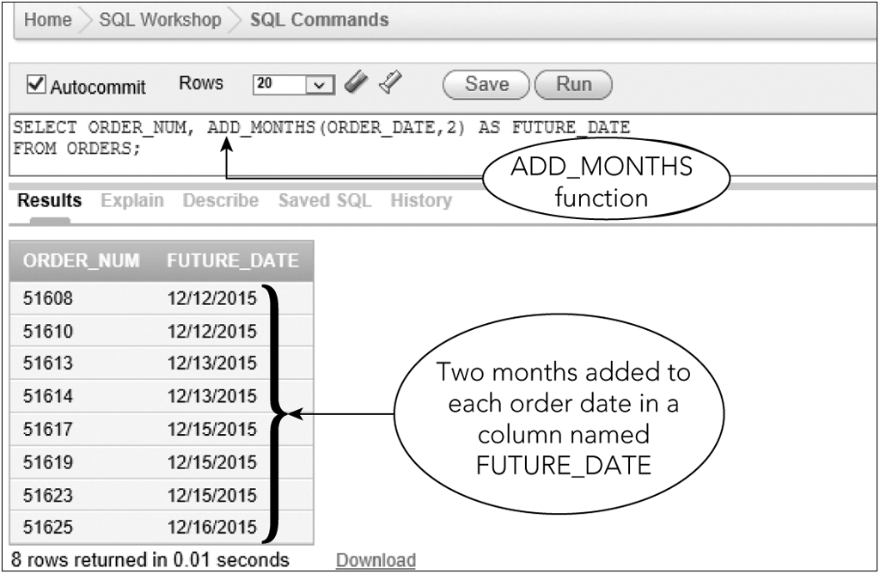
Working with Dates (continued)
Figure 8-3: Using the ADD_MONTHS function to add months to a date
©2016 Cengage Learning. All Rights Reserved. May not be copied, scanned, or duplicated, in whole or in part, except for use as permitted in a license distributed with a certain product or service or otherwise on a password-protected website for classroom use.

Slide 15
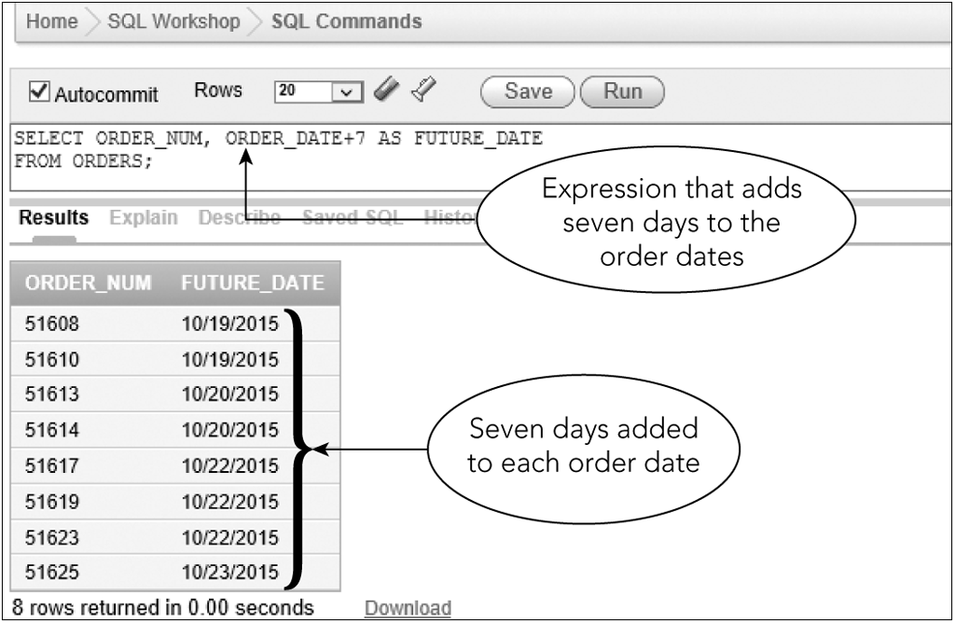
Working with Dates (continued)
Figure 8-4: Adding days to dates
©2016 Cengage Learning. All Rights Reserved. May not be copied, scanned, or duplicated, in whole or in part, except for use as permitted in a license distributed with a certain product or service or otherwise on a password-protected website for classroom use.

Slide 16
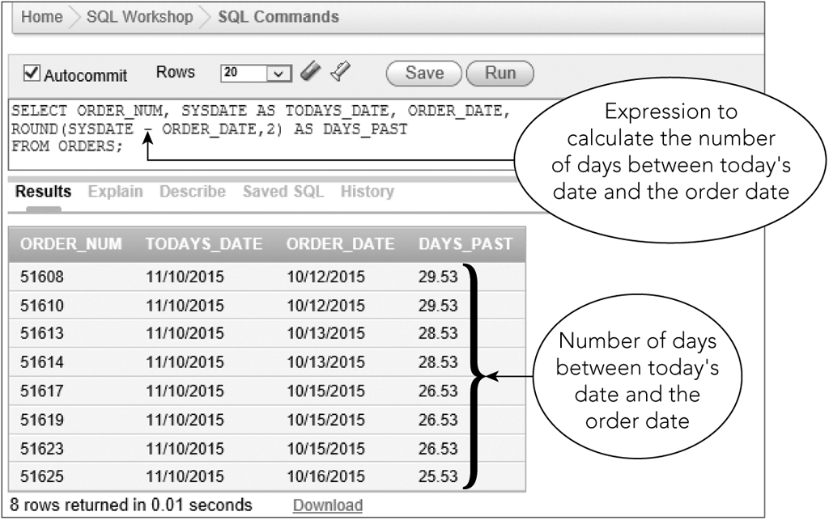
Working with Dates (continued)
Figure 8-5: Calculating the number of days between two dates
©2016 Cengage Learning. All Rights Reserved. May not be copied, scanned, or duplicated, in whole or in part, except for use as permitted in a license distributed with a certain product or service or otherwise on a password-protected website for classroom use.

Slide 17
Concatenating Columns
Concatenate
  Combine two or more columns into a single expression
  Type two vertical lines (||) (Oracle)
    & symbol (Access)
    + symbol (SQL Server)
  RTRIM function
    Removes extra spaces to the right of a value
©2016 Cengage Learning. All Rights Reserved. May not be copied, scanned, or duplicated, in whole or in part, except for use as permitted in a license distributed with a certain product or service or otherwise on a password-protected website for classroom use.

Slide 18
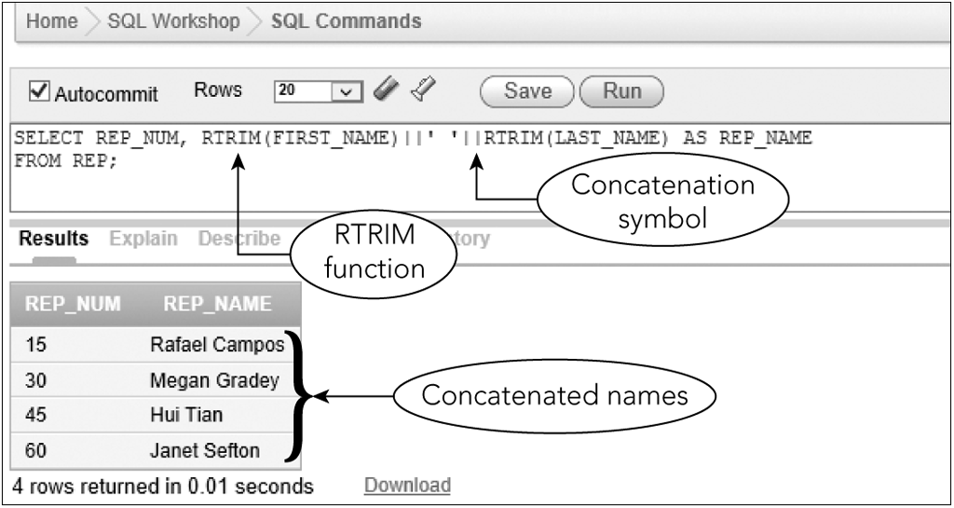
Concatenating Columns (continued)
Figure 8-6: Concatenating two columns and using the RTRIM function
©2016 Cengage Learning. All Rights Reserved. May not be copied, scanned, or duplicated, in whole or in part, except for use as permitted in a license distributed with a certain product or service or otherwise on a password-protected website for classroom use.

Slide 19
Stored Procedures
Useful in client/server systems
Advantages
  Procedure is stored on server; DBMS compiles stored procedure; creates compiled, optimized code to run
  Convenience (reduces typing)
Access does not support
©2016 Cengage Learning. All Rights Reserved. May not be copied, scanned, or duplicated, in whole or in part, except for use as permitted in a license distributed with a certain product or service or otherwise on a password-protected website for classroom use.

Slide 20
Retrieving a Single Row and Column (continued)
Use CREATE PROCEDURE command
%TYPE attribute ensures that variable has same data type as a particular column
Procedural code located between BEGIN and END commands
Each variable declaration and command as well as the word END are followed by semicolons
The slash (/) at the end of the program appears on its own line
©2016 Cengage Learning. All Rights Reserved. May not be copied, scanned, or duplicated, in whole or in part, except for use as permitted in a license distributed with a certain product or service or otherwise on a password-protected website for classroom use.

Slide 21
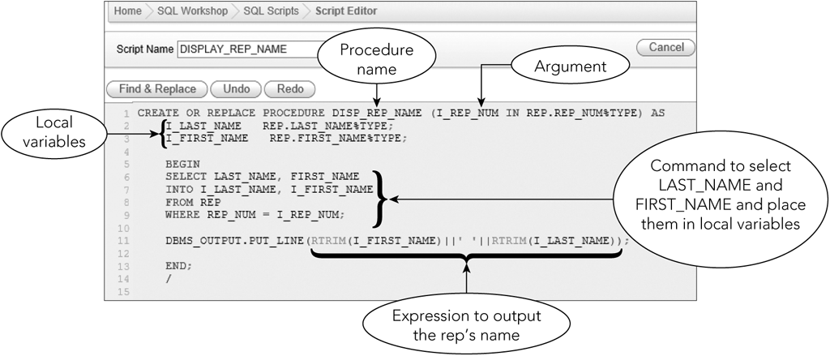
Retrieving a Single Row and Column
Figure 8-7: Procedure to find a rep’s name given the rep’s number
©2016 Cengage Learning. All Rights Reserved. May not be copied, scanned, or duplicated, in whole or in part, except for use as permitted in a license distributed with a certain product or service or otherwise on a password-protected website for classroom use.

Slide 22
Retrieving a Single Row and Column (continued)
When executed, user will be prompted for a value for I_REP_NUM
That value will be used to retrieve the last name and first name of the sales rep whose number equals this value
The results will be placed in the variables I_LAST_NAME, I_FIRST_NAME
DBMS_OUTPUT.PUT_LINE displays concatenated and trimmed rep’s name
©2016 Cengage Learning. All Rights Reserved. May not be copied, scanned, or duplicated, in whole or in part, except for use as permitted in a license distributed with a certain product or service or otherwise on a password-protected website for classroom use.

Slide 23
Retrieving a Single Row and Column (continued)
DBMS_OUTPUT is a package that contains multiple procedures
To call procedure:
  Type BEGIN, the name of the procedure, argument in parentheses, END, semicolon, slash
©2016 Cengage Learning. All Rights Reserved. May not be copied, scanned, or duplicated, in whole or in part, except for use as permitted in a license distributed with a certain product or service or otherwise on a password-protected website for classroom use.

Slide 24
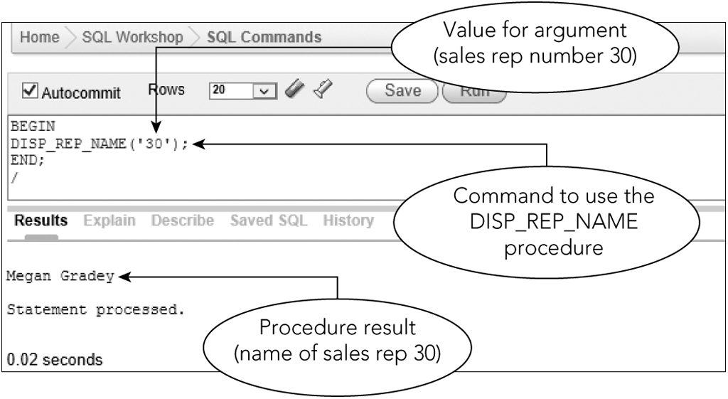
Retrieving a Single Row and Column
Figure 8-8: Using the DISP_REP_NAME procedure within an SQL command
©2016 Cengage Learning. All Rights Reserved. May not be copied, scanned, or duplicated, in whole or in part, except for use as permitted in a license distributed with a certain product or service or otherwise on a password-protected website for classroom use.

Slide 25
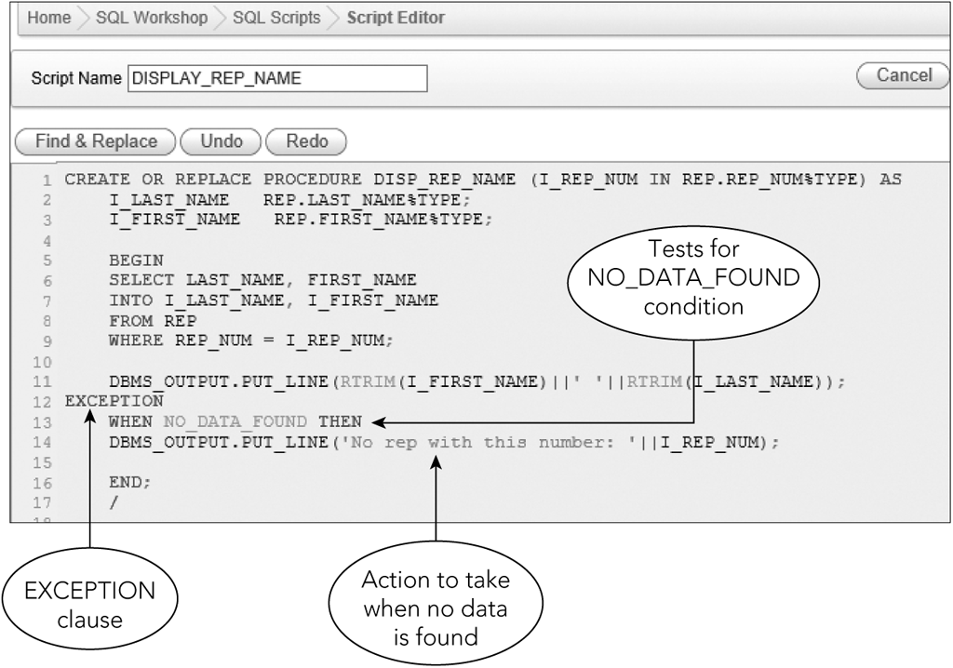
Error Handling
Use EXCEPTION clause
  Print an error message
Figure 8-10: PL/SQL procedure with error handling
©2016 Cengage Learning. All Rights Reserved. May not be copied, scanned, or duplicated, in whole or in part, except for use as permitted in a license distributed with a certain product or service or otherwise on a password-protected website for classroom use.

Slide 26
Using Update Procedures
Update procedure
  A procedure that updates data
©2016 Cengage Learning. All Rights Reserved. May not be copied, scanned, or duplicated, in whole or in part, except for use as permitted in a license distributed with a certain product or service or otherwise on a password-protected website for classroom use.

Slide 27
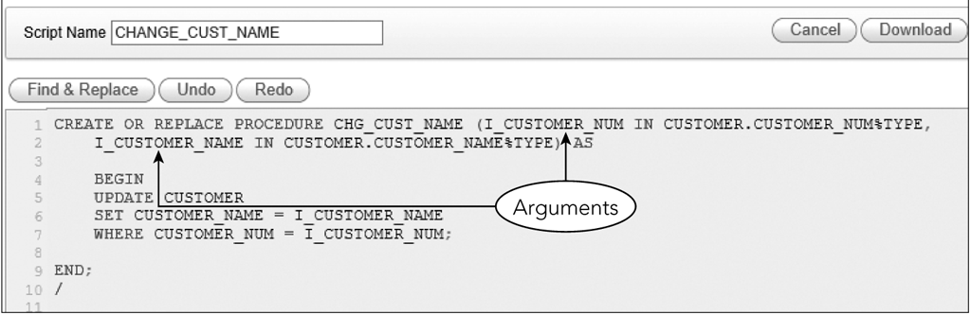
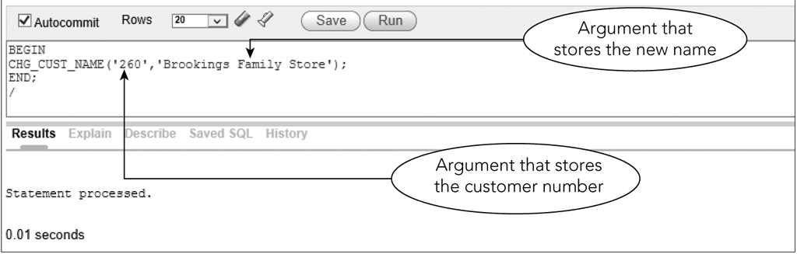
Changing Data with a Procedure
Figure 8-12: Using a procedure to update a row
Figure 8-13: Using a procedure to update the name of customer 260
©2016 Cengage Learning. All Rights Reserved. May not be copied, scanned, or duplicated, in whole or in part, except for use as permitted in a license distributed with a certain product or service or otherwise on a password-protected website for classroom use.

Slide 28
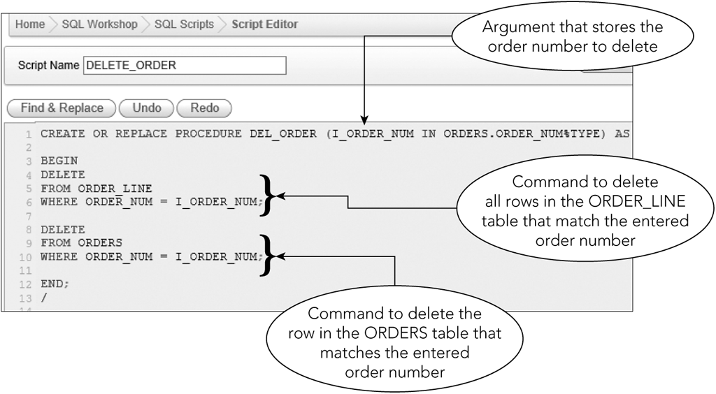
Deleting Data with a Procedure
Figure 8-14: Procedure to delete a row and related rows from multiple tables
©2016 Cengage Learning. All Rights Reserved. May not be copied, scanned, or duplicated, in whole or in part, except for use as permitted in a license distributed with a certain product or service or otherwise on a password-protected website for classroom use.

Slide 29
Selecting Multiple Rows with a Procedure
PL/SQL can process only one record at a time
©2016 Cengage Learning. All Rights Reserved. May not be copied, scanned, or duplicated, in whole or in part, except for use as permitted in a license distributed with a certain product or service or otherwise on a password-protected website for classroom use.

Slide 30
Using a Cursor
A cursor is a pointer to a row in the collection of rows retrieved by a SQL command
A cursor advances one row at a time to provide sequential one-record-at-a-time access to retrieved rows
©2016 Cengage Learning. All Rights Reserved. May not be copied, scanned, or duplicated, in whole or in part, except for use as permitted in a license distributed with a certain product or service or otherwise on a password-protected website for classroom use.

Slide 31
Using a Cursor (continued)
The first step is to declare the cursor and describe the associated query in the declaration section
  CURSOR CUSTGROUP IS
  SELECT CUSTOMER_NUM, CUSTOMER_NAME
  FROM CUSTOMER
  WHERE REP_NUM = I_REP_NUM;
Three commands are needed
  OPEN, FETCH, CLOSE
©2016 Cengage Learning. All Rights Reserved. May not be copied, scanned, or duplicated, in whole or in part, except for use as permitted in a license distributed with a certain product or service or otherwise on a password-protected website for classroom use.

Slide 32
Opening a Cursor
OPEN command
  Opens cursor
  Causes query to be executed
  Makes results available to the program
Prior to opening, there are no rows available to be fetched
OPEN CUSTGROUP
©2016 Cengage Learning. All Rights Reserved. May not be copied, scanned, or duplicated, in whole or in part, except for use as permitted in a license distributed with a certain product or service or otherwise on a password-protected website for classroom use.

Slide 33
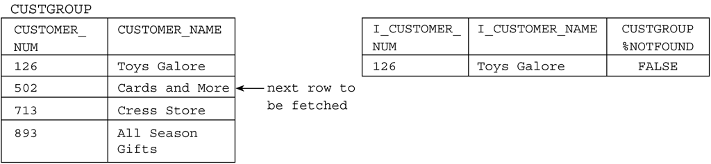
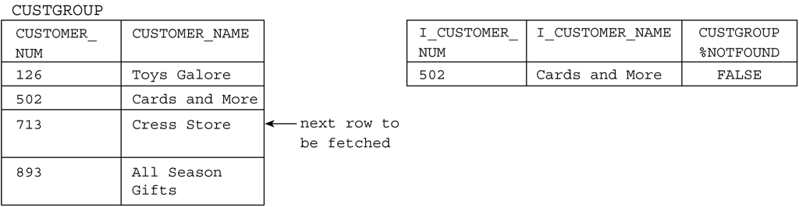
Opening a Cursor (continued)
Figure 8-16: Before OPEN
Figure 8-17: After OPEN, but before first FETCH
©2016 Cengage Learning. All Rights Reserved. May not be copied, scanned, or duplicated, in whole or in part, except for use as permitted in a license distributed with a certain product or service or otherwise on a password-protected website for classroom use.

Slide 34
Fetching Rows from a Cursor
FETCH command
  Advances cursor to next row in set of retrieved rows
  Places contents of row in indicated variables
FETCH CUSTGROUP INTO I_CUSTOMER_NUM,
I_CUSTOMER_NAME;
Execution of fetch command produces only a single row
©2016 Cengage Learning. All Rights Reserved. May not be copied, scanned, or duplicated, in whole or in part, except for use as permitted in a license distributed with a certain product or service or otherwise on a password-protected website for classroom use.

Slide 35
Fetching Rows from a Cursor (continued)
Figure 8-18: After first FETCH
Figure 8-19: After second FETCH
©2016 Cengage Learning. All Rights Reserved. May not be copied, scanned, or duplicated, in whole or in part, except for use as permitted in a license distributed with a certain product or service or otherwise on a password-protected website for classroom use.

Slide 36
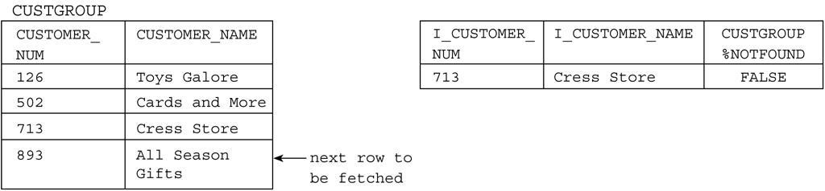
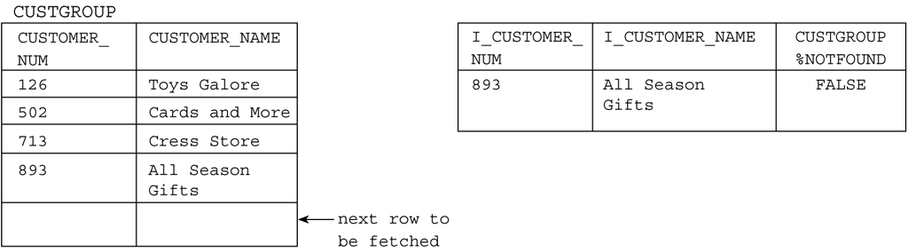
Fetching Rows from a Cursor (continued)
Figure 8-20: After third FETCH
Figure 8-21: After fourth FETCH
©2016 Cengage Learning. All Rights Reserved. May not be copied, scanned, or duplicated, in whole or in part, except for use as permitted in a license distributed with a certain product or service or otherwise on a password-protected website for classroom use.

Slide 37
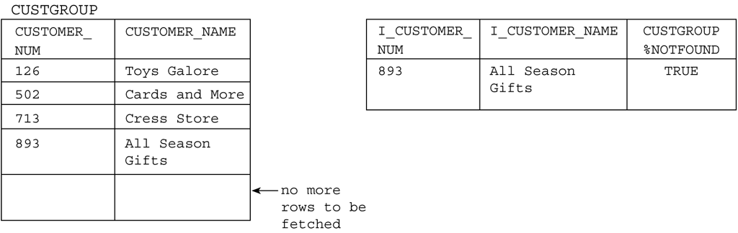
Fetching Rows from a Cursor (continued)
Figure 8-22: After attempting a fifth FETCH (CUSTGROUP%NOTFOUND is TRUE
©2016 Cengage Learning. All Rights Reserved. May not be copied, scanned, or duplicated, in whole or in part, except for use as permitted in a license distributed with a certain product or service or otherwise on a password-protected website for classroom use.

Slide 38
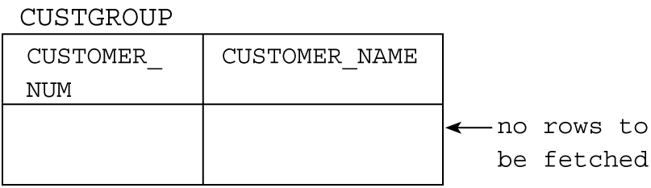
Closing a Cursor
CLOSE command
  Closes a cursor and deactivates it
  Data retrieved by execution of the query is no longer available
Figure 8-23: After CLOSE
©2016 Cengage Learning. All Rights Reserved. May not be copied, scanned, or duplicated, in whole or in part, except for use as permitted in a license distributed with a certain product or service or otherwise on a password-protected website for classroom use.

Slide 39
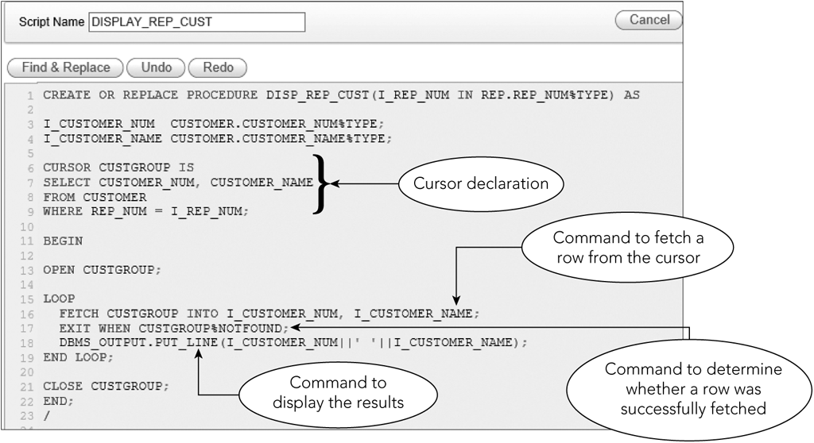
Writing a Complete Procedure Using a Cursor
Figure 8-24: Procedure with a cursor
©2016 Cengage Learning. All Rights Reserved. May not be copied, scanned, or duplicated, in whole or in part, except for use as permitted in a license distributed with a certain product or service or otherwise on a password-protected website for classroom use.

Slide 40
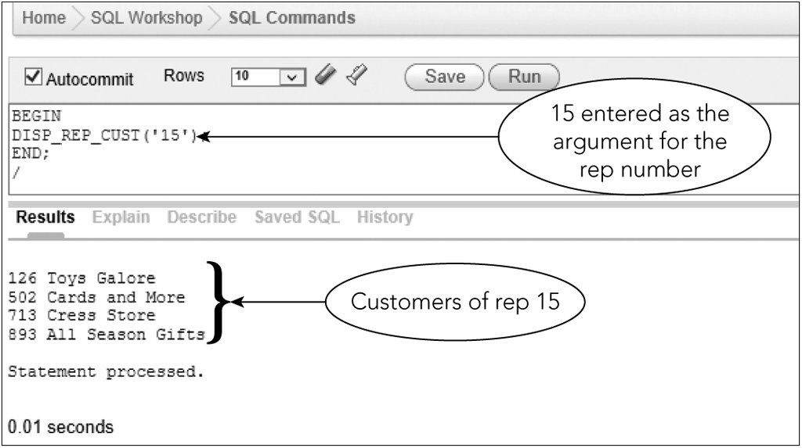
Writing a Complete Procedure Using a Cursor (continued)
Figure 8-25: Results of using the procedure
©2016 Cengage Learning. All Rights Reserved. May not be copied, scanned, or duplicated, in whole or in part, except for use as permitted in a license distributed with a certain product or service or otherwise on a password-protected website for classroom use.

Slide 41
Using More Complex Cursors
Any SLQ query is legitimate in a cursor definition
More complicated retrieval requirements result in greater benefits
©2016 Cengage Learning. All Rights Reserved. May not be copied, scanned, or duplicated, in whole or in part, except for use as permitted in a license distributed with a certain product or service or otherwise on a password-protected website for classroom use.

Slide 42
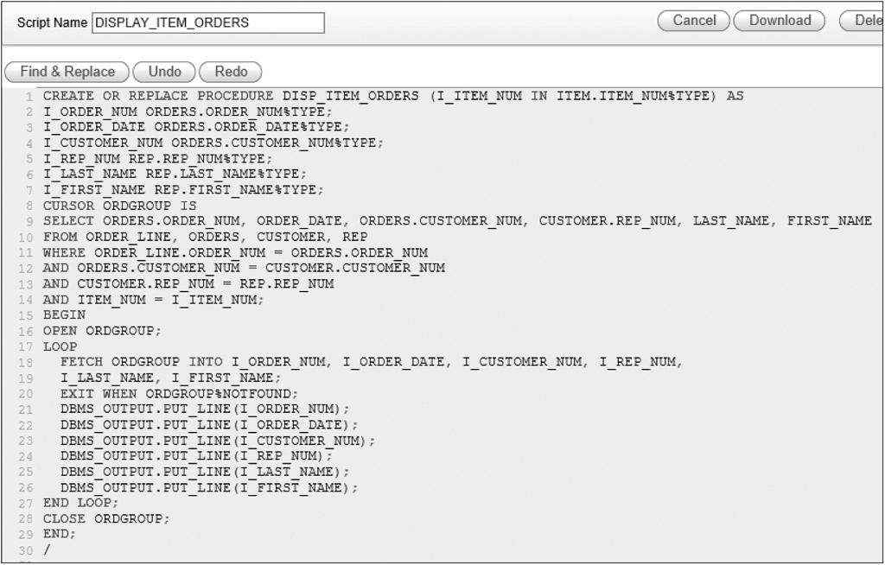
Using More Complex Cursors (continued)
Figure 8-26: Procedure with a cursor that involves joining multiple tables
©2016 Cengage Learning. All Rights Reserved. May not be copied, scanned, or duplicated, in whole or in part, except for use as permitted in a license distributed with a certain product or service or otherwise on a password-protected website for classroom use.

Slide 43
Advantages of Cursors
Simplifies coding in the program
Programs with embedded SQL utilize the optimizer
  Programmer doesn’t worry about the best way to retrieve data
  Program doesn’t have to change even if the underlying structure does
Cursor definition only changes; not procedural code
©2016 Cengage Learning. All Rights Reserved. May not be copied, scanned, or duplicated, in whole or in part, except for use as permitted in a license distributed with a certain product or service or otherwise on a password-protected website for classroom use.

Slide 44
Using T-SQL in SQL Server
T-SQL or Transact-SQL
  Extended version of SQL
  Create stored procedures and use cursors
©2016 Cengage Learning. All Rights Reserved. May not be copied, scanned, or duplicated, in whole or in part, except for use as permitted in a license distributed with a certain product or service or otherwise on a password-protected website for classroom use.

Slide 45
Retrieving a Single Row and Column
Must assign data type to parameters
Arguments start with @
Use EXEC command to call a procedure
CREATE PROCEDURE usp_DISP_REP_NAME
@repnum char(2)
AS
SELECT RTRIM(FIRST_NAME)+' '+RTRIM(LAST_NAME)
FROM REP
WHERE REP_NUM = @repnum
EXEC usp_DISP_REP_NAME'20'
©2016 Cengage Learning. All Rights Reserved. May not be copied, scanned, or duplicated, in whole or in part, except for use as permitted in a license distributed with a certain product or service or otherwise on a password-protected website for classroom use.

Slide 46
Changing Data with a Stored Procedure
CREATE PROCEDURE usp_CHG_CUST_NAME
@custnum char(3),
@custname char(35)
AS
UPDATE CUSTOMER
SET CUSTOMER_NAME = @custname
WHERE CUSTOMER_NUM = @custnum
EXEC usp_CHG_CUST_NAME'260',‘Brookings Family Store'
©2016 Cengage Learning. All Rights Reserved. May not be copied, scanned, or duplicated, in whole or in part, except for use as permitted in a license distributed with a certain product or service or otherwise on a password-protected website for classroom use.

Slide 47
Deleting Data with a Stored Procedure
CREATE PROCEDURE usp_DEL_ORDER
@ordernum char(5)
AS
DELETE
FROM ORDER_LINE
WHERE ORDER_NUM = @ordernum
DELETE
FROM ORDERS
WHERE ORDER_NUM = @ordernum
©2016 Cengage Learning. All Rights Reserved. May not be copied, scanned, or duplicated, in whole or in part, except for use as permitted in a license distributed with a certain product or service or otherwise on a password-protected website for classroom use.

Slide 48
Using a Cursor
CREATE PROCEDURE usp_DISP_REP_CUST
@repnum char(2)
AS
DECLARE @custnum char(3)
DECLARE @custname char(35)
DECLARE mycursor CURSOR READ_ONLY
FOR
SELECT CUSTOMER_NUM, CUSTOMER_NAME
FROM CUSTOMER
WHERE REP_NUM = @repnum
OPEN mycursor
FETCH NEXT FROM mycursor
INTO @custnum, @custname
WHILE @@FETCH_STATUS = 0
BEGIN
PRINT @custnum+' '+@custname
FETCH NEXT FROM mycursor
INTO @custnum, @custname
END
CLOSE mycursor
DEALLOCATE mycursor
©2016 Cengage Learning. All Rights Reserved. May not be copied, scanned, or duplicated, in whole or in part, except for use as permitted in a license distributed with a certain product or service or otherwise on a password-protected website for classroom use.

Slide 49
Using More Complex Cursors
Declare all variables
Declare cursor
SELECT statement
Open cursor
Fetch
While loop
Close cursor
Deallocate cursor
©2016 Cengage Learning. All Rights Reserved. May not be copied, scanned, or duplicated, in whole or in part, except for use as permitted in a license distributed with a certain product or service or otherwise on a password-protected website for classroom use.

Slide 50
Using SQL in Microsoft Access
In Access, programs are written in Visual Basic
Does not allow inclusion of SQL commands in the code
If the SQL command is stored in string variable, use the DoCmd.RunSQL command
©2016 Cengage Learning. All Rights Reserved. May not be copied, scanned, or duplicated, in whole or in part, except for use as permitted in a license distributed with a certain product or service or otherwise on a password-protected website for classroom use.

Slide 51
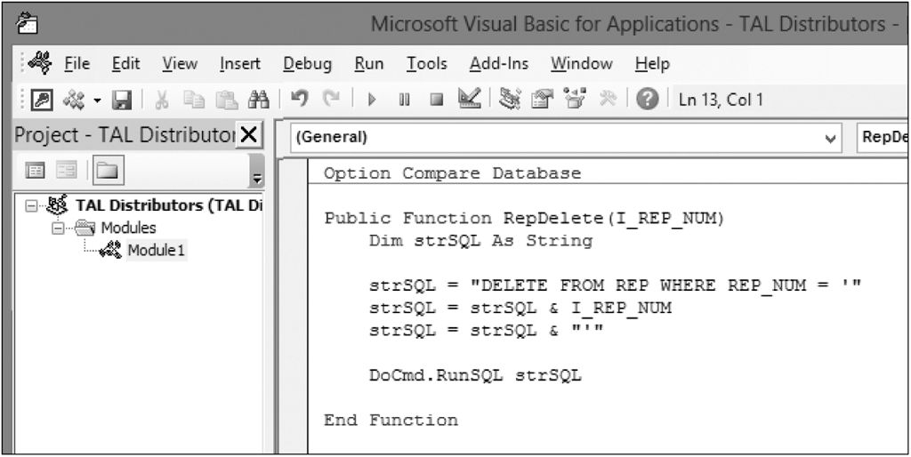
Deleting Data with Visual Basic
Place the SQL command in the procedure, including arguments
Figure 8-28: Visual Basic code to delete a sales rep
©2016 Cengage Learning. All Rights Reserved. May not be copied, scanned, or duplicated, in whole or in part, except for use as permitted in a license distributed with a certain product or service or otherwise on a password-protected website for classroom use.

Slide 52
Running the Code
Normally run by calling it from another procedure or by associating it with an event
Can be run by using the Immediate window
Normally used for testing
©2016 Cengage Learning. All Rights Reserved. May not be copied, scanned, or duplicated, in whole or in part, except for use as permitted in a license distributed with a certain product or service or otherwise on a password-protected website for classroom use.

Slide 53
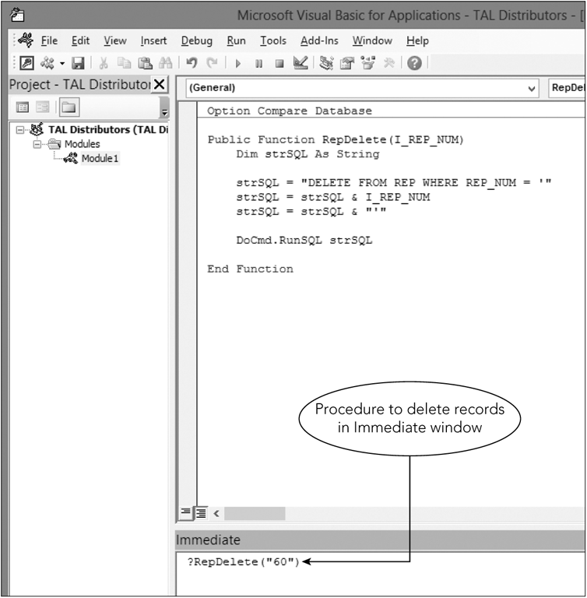
Running the Code (continued)
Figure 8-29: Running the code in the Immediate window
©2016 Cengage Learning. All Rights Reserved. May not be copied, scanned, or duplicated, in whole or in part, except for use as permitted in a license distributed with a certain product or service or otherwise on a password-protected website for classroom use.

Slide 54
Updating Data with Visual Basic
Similar to the procedure to delete a sales rep, except:
  Need the UPDATE command
  Two arguments rather than one
    Two portions of the construction of the SQL command that involve variables
©2016 Cengage Learning. All Rights Reserved. May not be copied, scanned, or duplicated, in whole or in part, except for use as permitted in a license distributed with a certain product or service or otherwise on a password-protected website for classroom use.

Slide 55
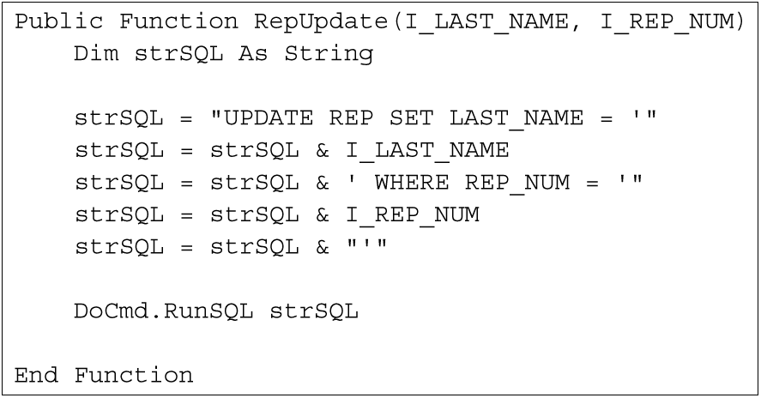
Updating Data with Visual Basic (continued)
Figure 8-30: Code to change a rep’s last name
©2016 Cengage Learning. All Rights Reserved. May not be copied, scanned, or duplicated, in whole or in part, except for use as permitted in a license distributed with a certain product or service or otherwise on a password-protected website for classroom use.

Slide 56
Inserting Data with Visual Basic
Process is similar
Create the appropriate INSERT command in the strSQL variable
Multiple arguments
One for each value inserted
©2016 Cengage Learning. All Rights Reserved. May not be copied, scanned, or duplicated, in whole or in part, except for use as permitted in a license distributed with a certain product or service or otherwise on a password-protected website for classroom use.

Slide 57
Finding Multiple Rows with Visual Basic
SELECT commands handled differently than in PL/SQL
No cursors
Handle results of query just as you would use a loop to process through the records on the table
©2016 Cengage Learning. All Rights Reserved. May not be copied, scanned, or duplicated, in whole or in part, except for use as permitted in a license distributed with a certain product or service or otherwise on a password-protected website for classroom use.

Slide 58
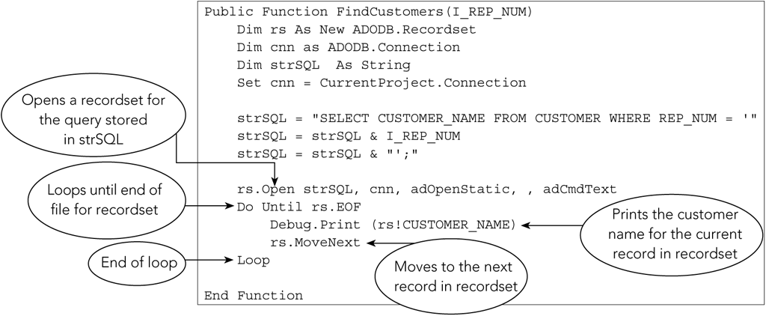
Finding Multiple Rows with Visual Basic (continued)
Figure 8-32: Code to find customers of a specific rep
©2016 Cengage Learning. All Rights Reserved. May not be copied, scanned, or duplicated, in whole or in part, except for use as permitted in a license distributed with a certain product or service or otherwise on a password-protected website for classroom use.

Slide 59
Using a Trigger
Procedure that is executed automatically in response to an associated database operation
CREATE TRIGGER
SQL commands between BEGIN and END
NEW qualifier refers to row that is added
OLD qualifier refers to row that was deleted or updated
©2016 Cengage Learning. All Rights Reserved. May not be copied, scanned, or duplicated, in whole or in part, except for use as permitted in a license distributed with a certain product or service or otherwise on a password-protected website for classroom use.

Slide 60
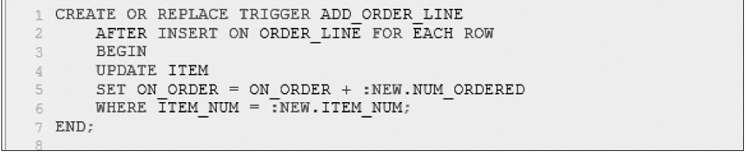
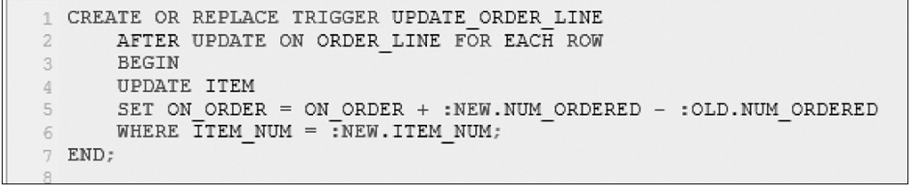
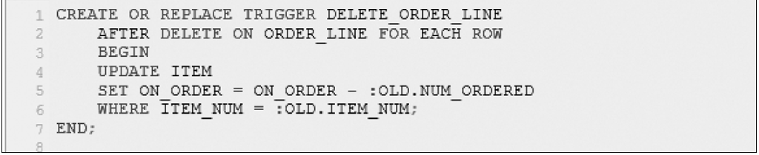
Using a Trigger (continued)
Figure 8-34: ADD_ORDER_LINE trigger
Figure 8-35: UPDATE_ORDER_LINE trigger
Figure 8-36: DELETE_ORDER_LINE trigger
©2016 Cengage Learning. All Rights Reserved. May not be copied, scanned, or duplicated, in whole or in part, except for use as permitted in a license distributed with a certain product or service or otherwise on a password-protected website for classroom use.

Slide 61
Using a Trigger (continued)
T-SQL (example of trigger after INSERT)
CREATE TRIGGER ADD_ORDER_LINE
ON ORDER_LINE
AFTER INSERT
AS
DECLARE @numbord decimal(3,0)
SELECT @numbord = (SELECT NUM_ORDERED FROM INSERTED)
UPDATE ITEM
SET ON_0RDER = ON_ORDER + @numbord
©2016 Cengage Learning. All Rights Reserved. May not be copied, scanned, or duplicated, in whole or in part, except for use as permitted in a license distributed with a certain product or service or otherwise on a password-protected website for classroom use.

Slide 62
Summary
Functions
  Character (UPPER, LOWER)
  Numeric (ROUND, FLOOR)
  Date (ADD_MONTHS, SYSDATE)
Concatenation
  RTRIM
  (||) lines
Stored procedure
  Query saved in a file that users can execute later
  CREATE PROCEDURE
©2016 Cengage Learning. All Rights Reserved. May not be copied, scanned, or duplicated, in whole or in part, except for use as permitted in a license distributed with a certain product or service or otherwise on a password-protected website for classroom use.

Slide 63
Summary (continued)
Variables
  Declare
  %TYPE attribute
  INTO clause in SELECT places results in variables
INSERT, UPDATE, and DELETE in PL/SQL and T-SQL
Cursors
  OPEN, FETCH, CLOSE
©2016 Cengage Learning. All Rights Reserved. May not be copied, scanned, or duplicated, in whole or in part, except for use as permitted in a license distributed with a certain product or service or otherwise on a password-protected website for classroom use.

Slide 64
Summary (continued)
SQL commands in Access
  Create in string variable
  Run with DoCmd.RunSQL command
Trigger
  Action that occurs automatically
  Stored and compiled on server
  Executed in response to a database operation
©2016 Cengage Learning. All Rights Reserved. May not be copied, scanned, or duplicated, in whole or in part, except for use as permitted in a license distributed with a certain product or service or otherwise on a password-protected website for classroom use.

